Slide 1


Python Fundamentals
Innovation Masters
Day 6

Slide 2
Today’s Agenda
Greetings and catching up
Recap
Making menus
Making loops
Extended Tech Talk about Robotics

Slide 3
Previously in Python Fundamentals…
We learn what variables are and how to use them
How to take user input
How to convert variables from one type to another (typecasting)
Commenting (#)
Making decisions (if/else statements)

Slide 4
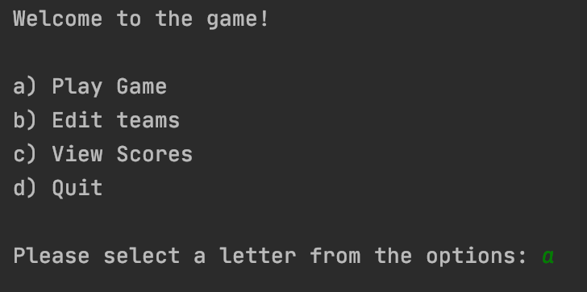
Now we will make a nice menu
In your applications or games, you have menu screens from where you choose what to do
For ex: play game, rules, view high score, make new document, edit, print

Slide 5
Using menus
Let’s make a menu and run commands accordingly
a) Fahrenheit to Celsius- take user input in Fahrenheit and convert to Celsius
b) Celsius to Fahrenheit- opposite of (a)
c) Age category- user input for age; age<=19- young, age<=45- middle age, age>45- old
d) Calculate salary- user input for hourly wage, and hours per week to get yearly earning
Salary = hourly wage * hours per week * 52

Slide 6
Fahrenheit and Celsius
#Converting from Fahrenheit to Celsius print("Welcome to temperature converter!") far = int(input("Enter Fahrenheit: ")) cel = (far - 32) * 5 / 9 print(cel)
#Converting from Celsius to Fahrenheit print("Welcome to temperature converter!") cel = int(input("Enter celsius: ")) far = (cel * 9 / 5) +32 print(far)

Slide 7
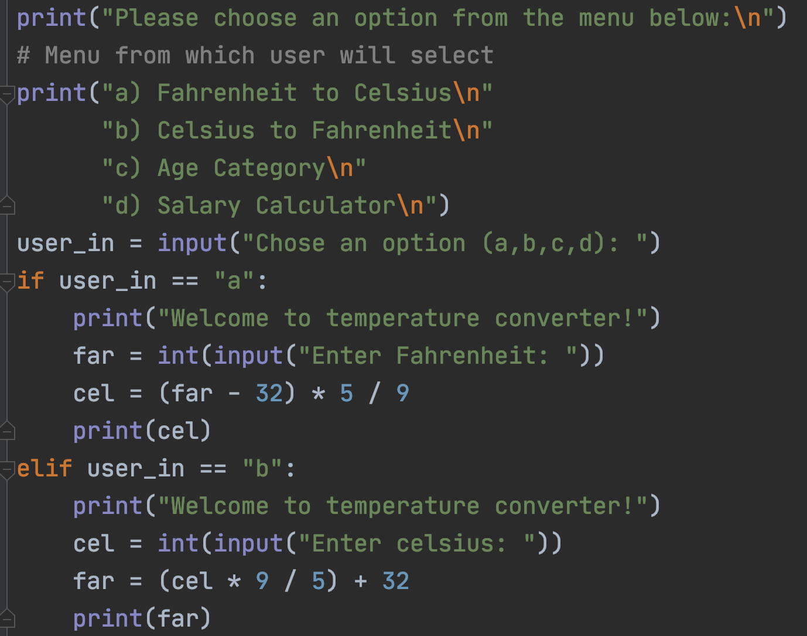
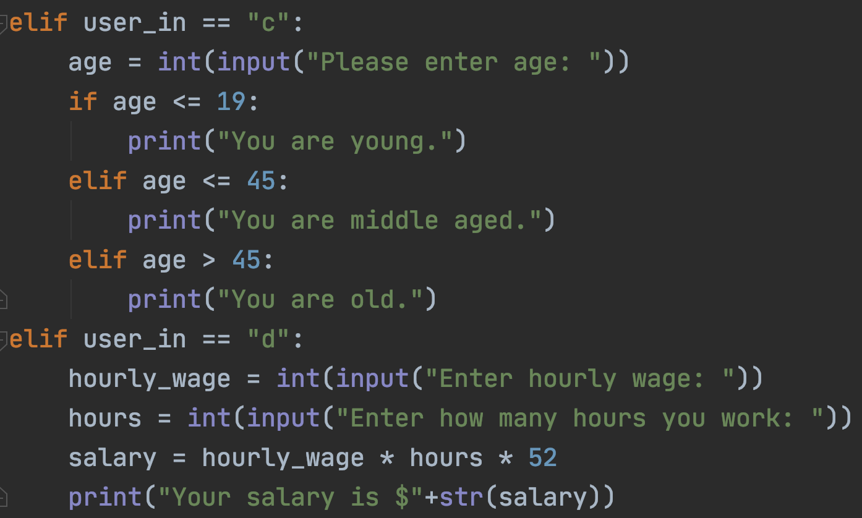
Solution to Menu Program
2
1

Slide 8
How to make our menu repeat
We will use a while loop and a Boolean
keep_going = True
while keep_going:
Print menu
Do what is asked by user
Keep repeating
Have a quit option
If user asks to quit, set keep_going to False and exit loop
Now let’s do the same thing to the program we made

Slide 9
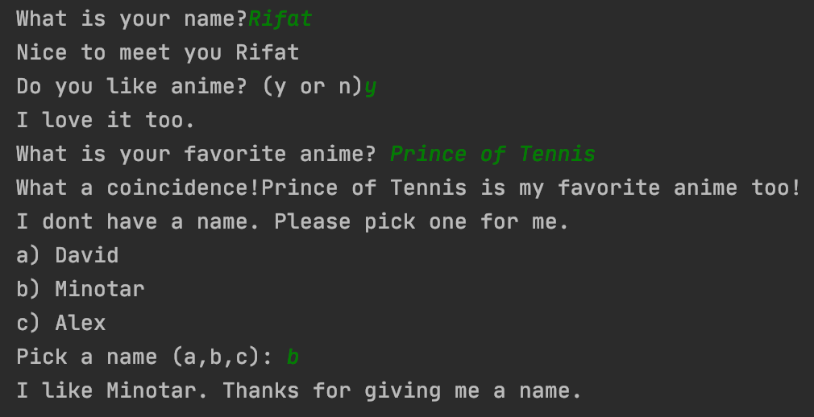
Homework
Make a simple story or a Q/A session using if/else statements

Slide 10
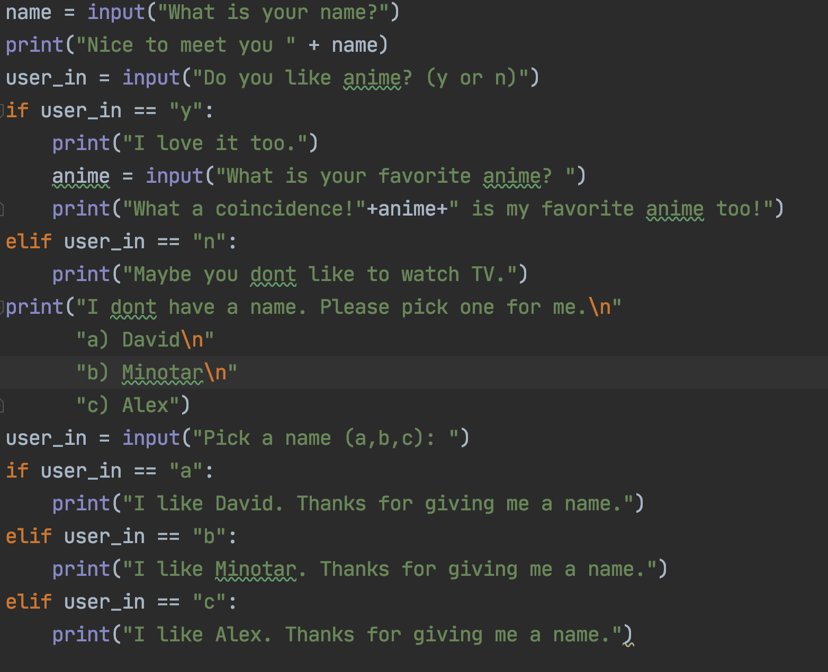
Code for the homework example

Slide 11
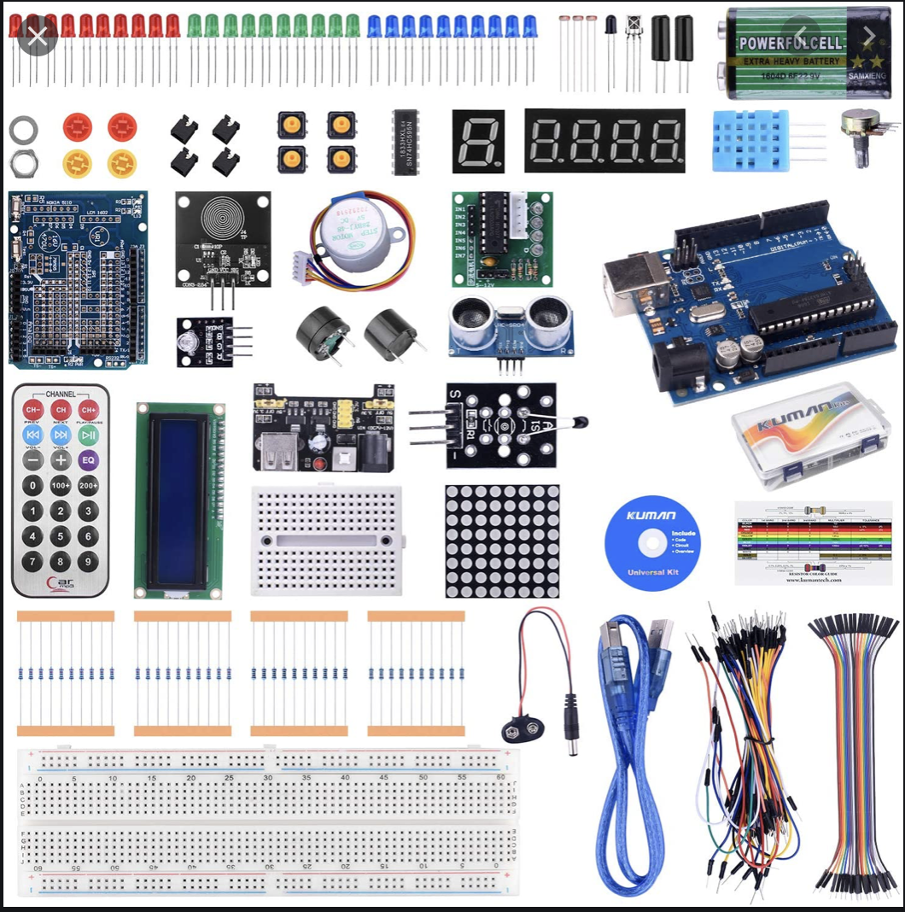
Tech Talk
Today’s topic is robotics
Using microcontrollers, some electrical components, and homemade parts we can easily make robots at very low costs

Slide 12
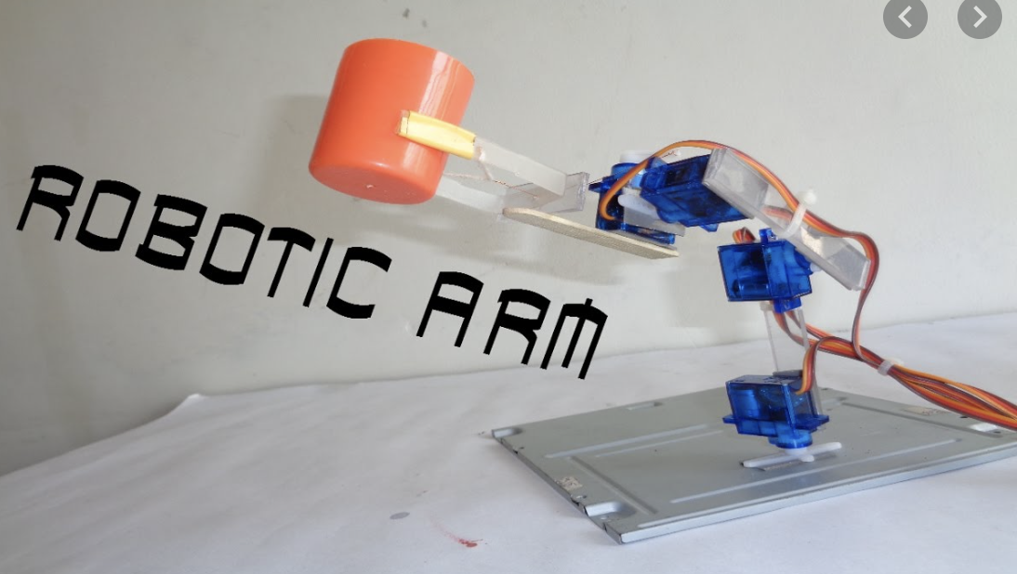
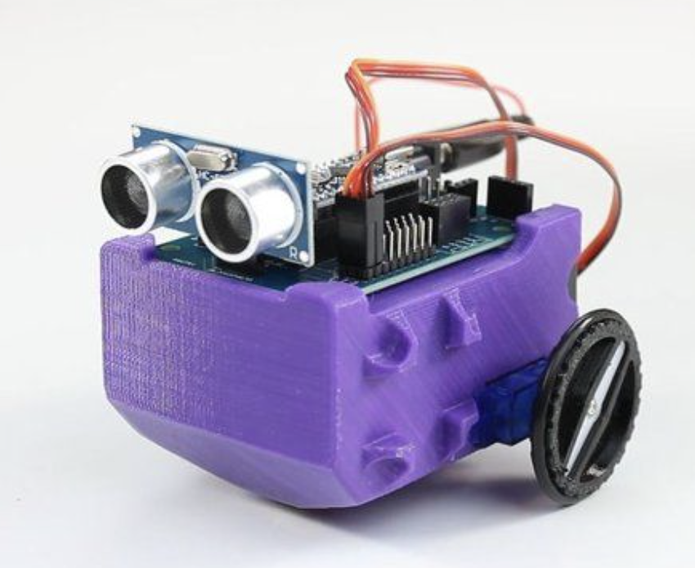
Some example robots

Slide 13
Some projects
Blinking LED- https://www.youtube.com/watch?v=dnPPoetX0uw
Self balancing- https://www.youtube.com/watch?v=I6z26LVu5y0&t=517s
Blastoise- https://www.youtube.com/watch?v=D6ZrfixRxWs
Student projects- https://www.youtube.com/watch?v=oJN-LKLNBXA&t=62s

Slide 14
Adios
Try
Try to enjoy school even though online might not be as fun
Do
Don’t always just watch youtube, try to make things whatever they maybe. Could be a toy, film, song, poem, dance move, new handshake, etc
Have
Have a fun weekend

